Slide 1
Free the Data: Introduction to Databases
Databases to Dashboards
Lesson 2

Slide 2
Lesson Objectives
Understand the structure of the data used for exercises in this course
Define table, attribute, record, and key in the context of relational databases
Write a simple structured query language (SQL) statement to retrieve information from a database
Explain the 3 principles of tidy data

Slide 3
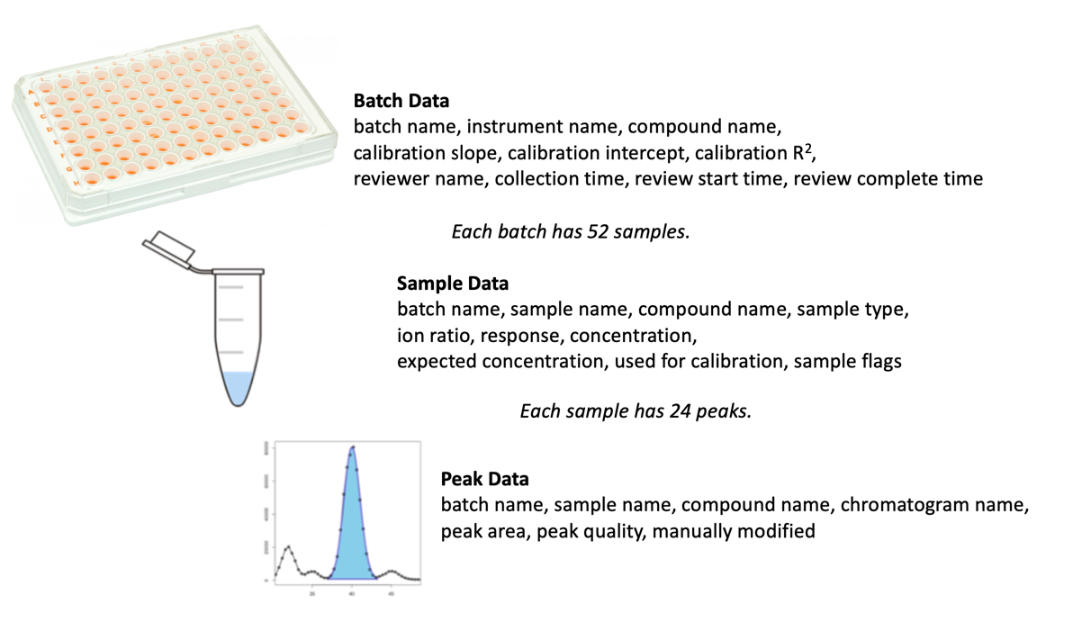
Course Data Summary

Slide 4
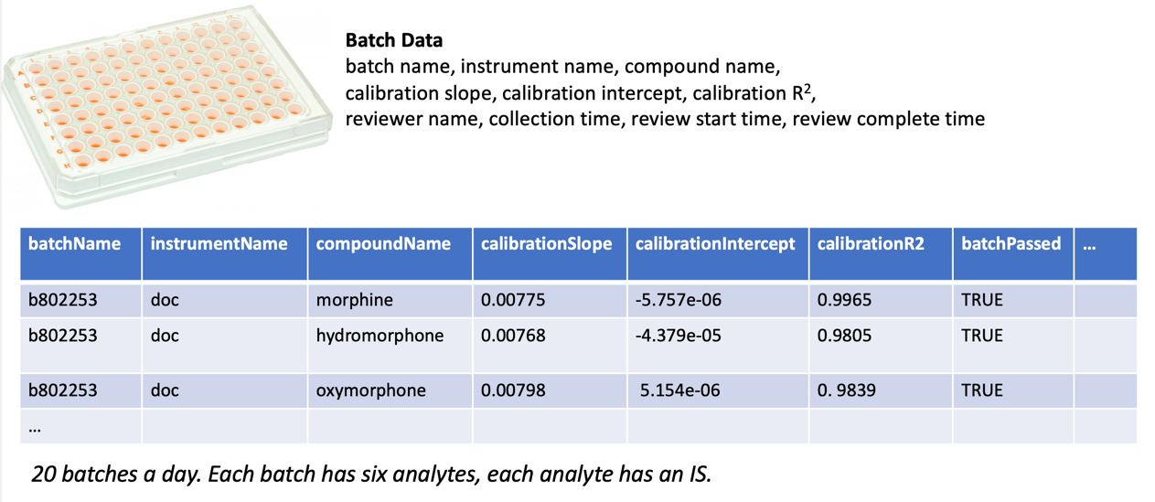
Batch Level Data: “_b” suffix

Slide 5
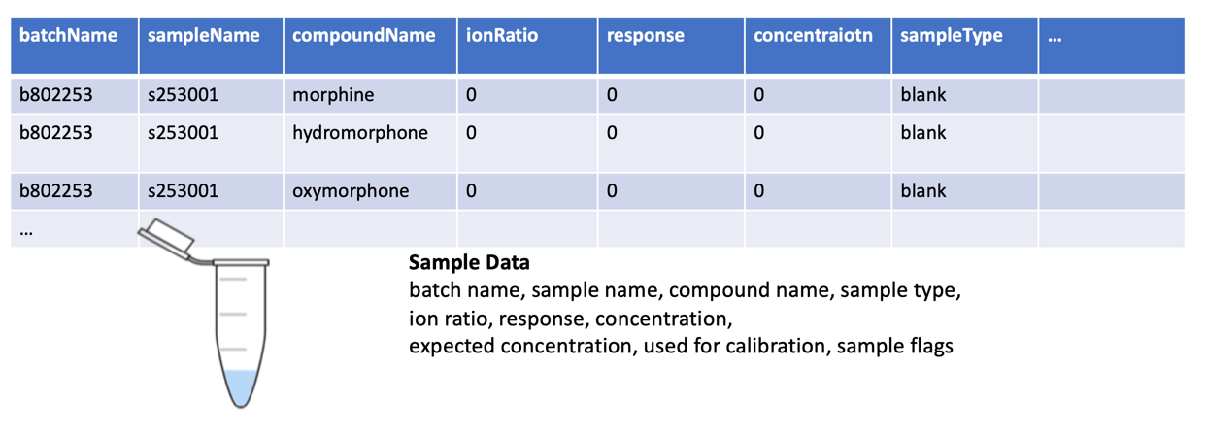
Sample Level Data: “_S” Suffix
52 samples in a batch = 1040 samples a day
7 standards, 3 QCs, 2 blanks, 40 unknowns per batch

Slide 6
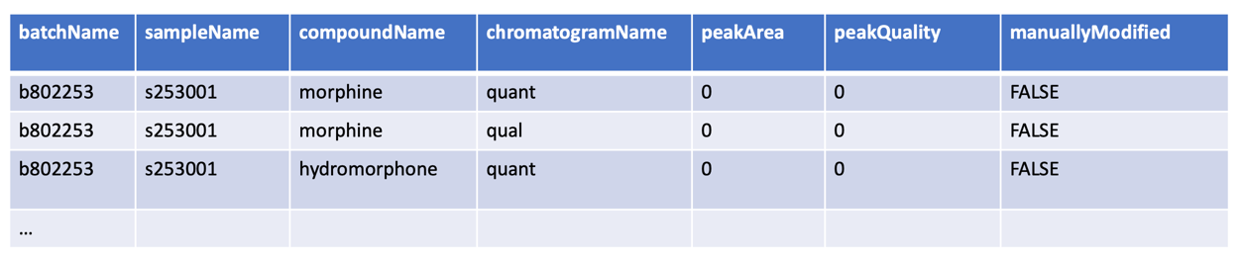
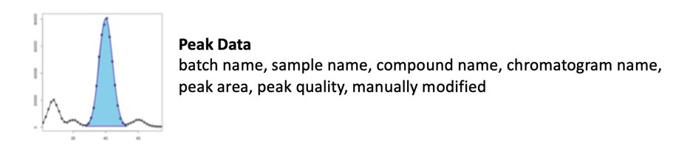
Peak Level Data: “_P” Suffix
24 chromatograms in a sample = 24960 chromatograms a day
Quant and Qual, for both the Analyte and the IS

Slide 7
Course Data Summary

Slide 8
Storage of Raw Data as Files is the Norm
Contexts outside of automated testing: analyses often grouped by batch/run
File export = convenient mechanism for capturing and storing data
Challenges:
Management of files – how can I organize my data so I can return to review individual data points?
Retrospective bulk data review – how do I look at data across multiple batches?
Big data sets – will all of my data fit into memory when I analyze it in R?

Slide 9
Relational Databases are an Established Technology for Managing Data at Scale
Edgar Codd described concept of relational database (DB) in 1970
Separate knowledge of data from native data structure
Goal: Represent data in a structure that end users could more easily understand

Slide 10
Advantages of Relational Databases for data management
Built-in rules and decisions for maintaining integrity of data
Understanding of native data format may not be required – common syntax for structured query language (SQL)
Higher performance for bulk data access
Wide variety of tools for accessing and analyzing data in relational DBs
Tools and expertise also broadly available for data management (data marts/warehouses/lakes)

Slide 11
Basic Vocabulary: Tables
batchName | instrumentName | compoundName | calibrationSlope | calibrationIntercept | calibrationR2 | batchPassed | reviewerName | batchCollectedTimestamp | reviewStartTimestamp | reviewCompleteTimestamp
b593231 | happy | morphine | 0.007069799 | -9.49E-06 | 0.99678318 | TRUE | Xavier | 2/6/17 21:10 | 2/7/17 9:45 | 2/7/17 10:10
b593231 | happy | hydromorphone | 0.007084087 | 3.84E-05 | 0.985821867 | TRUE | Xavier | 2/6/17 21:10 | 2/7/17 9:45 | 2/7/17 10:10
b593231 | happy | oxymorphone | 0.007420291 | -3.28E-05 | 0.996172223 | TRUE | Xavier | 2/6/17 21:10 | 2/7/17 9:45 | 2/7/17 10:10
b593231 | happy | codeine | 0.006790768 | -4.49E-05 | 0.98150435 | TRUE | Xavier | 2/6/17 21:10 | 2/7/17 9:45 | 2/7/17 10:10
b593231 | happy | hydrocodone | 0.007458148 | -3.35E-05 | 0.989524304 | TRUE | Xavier | 2/6/17 21:10 | 2/7/17 9:45 | 2/7/17 10:10
b593231 | happy | oxycodone | 0.007035611 | -3.54E-05 | 0.994844927 | TRUE | Xavier | 2/6/17 21:10 | 2/7/17 9:45 | 2/7/17 10:10
Batch Table

Slide 12
Basic Vocabulary: Tables
batchName | sampleName | compoundName | ionRatio | response | concentration | sampleType | expectedConcentration | usedForCurve | samplePassed
b593231 | s231002 | morphine | 0 | 0 | 0 | standard | 0 | TRUE | TRUE
b593231 | s231002 | hydromorphone | 0 | 0 | 0 | standard | 0 | TRUE | FALSE
b593231 | s231002 | oxymorphone | 0 | 0 | 0 | standard | 0 | TRUE | TRUE
b593231 | s231002 | codeine | 0 | 0 | 0 | standard | 0 | TRUE | TRUE
b593231 | s231002 | hydrocodone | 0 | 0 | 0 | standard | 0 | TRUE | TRUE
b593231 | s231002 | oxycodone | 0 | 0 | 0 | standard | 0 | TRUE | TRUE
b593231 | s231003 | morphine | 1.28313295 | 0.13735299 | 19.4294737 | standard | 20 | TRUE | TRUE
b593231 | s231003 | hydromorphone | 1.23216182 | 0.1496098 | 21.1137199 | standard | 20 | TRUE | TRUE
b593231 | s231003 | oxymorphone | 1.18908368 | 0.13051132 | 17.5928554 | standard | 20 | TRUE | TRUE
b593231 | s231003 | codeine | 1.21151951 | 0.11646534 | 17.1571545 | standard | 20 | TRUE | TRUE
b593231 | s231003 | hydrocodone | 1.13819676 | 0.13189799 | 17.6895806 | standard | 20 | TRUE | TRUE
b593231 | s231003 | oxycodone | 1.26800174 | 0.13123521 | 18.6580284 | standard | 20 | TRUE | TRUE
Sample Table

Slide 13
Basic Vocabulary: Tables
batchName | sampleName | compoundName | chromatogramName | peakArea | peakQuality | manuallyModified
b593231 | s231002 | codeine-d6 | quant | 101210.769 | 0.97 | FALSE
b593231 | s231002 | codeine-d6 | qual | 72830.159 | -1 | TRUE
b593231 | s231002 | hydrocodone-d3 | quant | 96368.0518 | 0.99 | FALSE
b593231 | s231002 | hydrocodone-d3 | qual | 63067.9334 | 0.97 | FALSE
b593231 | s231002 | oxycodone-d3 | quant | 101027.426 | 0.98 | FALSE
b593231 | s231002 | oxycodone-d3 | qual | 65133.7409 | 0.99 | FALSE
b593231 | s231003 | morphine | quant | 13820.4365 | 0.99 | FALSE
b593231 | s231003 | morphine | qual | 10770.8531 | 0.98 | FALSE
b593231 | s231003 | hydromorphone | quant | 14710.7105 | 0.99 | FALSE
b593231 | s231003 | hydromorphone | qual | 11938.9436 | 0.99 | FALSE
b593231 | s231003 | oxymorphone | quant | 13084.7389 | 0.97 | FALSE
b593231 | s231003 | oxymorphone | qual | 11004.0522 | 0.99 | FALSE
b593231 | s231003 | codeine | quant | 12129.006 | 0.99 | FALSE
b593231 | s231003 | codeine | qual | 10011.3997 | 1 | FALSE
Peak Table

Slide 14
Basic Vocabulary: Rows and Columns
batchName | sampleName | compoundName | ionRatio | response | concentration | sampleType | expectedConcentration | usedForCurve | samplePassed
b593231 | s231002 | morphine | 0 | 0 | 0 | standard | 0 | TRUE | TRUE
b593231 | s231002 | hydromorphone | 0 | 0 | 0 | standard | 0 | TRUE | FALSE
b593231 | s231002 | oxymorphone | 0 | 0 | 0 | standard | 0 | TRUE | TRUE
b593231 | s231002 | codeine | 0 | 0 | 0 | standard | 0 | TRUE | TRUE
b593231 | s231002 | hydrocodone | 0 | 0 | 0 | standard | 0 | TRUE | TRUE
b593231 | s231002 | oxycodone | 0 | 0 | 0 | standard | 0 | TRUE | TRUE
b593231 | s231003 | morphine | 1.28313295 | 0.13735299 | 19.4294737 | standard | 20 | TRUE | TRUE
b593231 | s231003 | hydromorphone | 1.23216182 | 0.1496098 | 21.1137199 | standard | 20 | TRUE | TRUE
b593231 | s231003 | oxymorphone | 1.18908368 | 0.13051132 | 17.5928554 | standard | 20 | TRUE | TRUE
b593231 | s231003 | codeine | 1.21151951 | 0.11646534 | 17.1571545 | standard | 20 | TRUE | TRUE
b593231 | s231003 | hydrocodone | 1.13819676 | 0.13189799 | 17.6895806 | standard | 20 | TRUE | TRUE
b593231 | s231003 | oxycodone | 1.26800174 | 0.13123521 | 18.6580284 | standard | 20 | TRUE | TRUE
Column =
Attribute in DB
Variable in R Tidy

Slide 15
Basic Vocabulary: Rows and Columns
batchName | sampleName | compoundName | ionRatio | response | concentration | sampleType | expectedConcentration | usedForCurve | samplePassed
b593231 | s231002 | morphine | 0 | 0 | 0 | standard | 0 | TRUE | TRUE
b593231 | s231002 | hydromorphone | 0 | 0 | 0 | standard | 0 | TRUE | FALSE
b593231 | s231002 | oxymorphone | 0 | 0 | 0 | standard | 0 | TRUE | TRUE
b593231 | s231002 | codeine | 0 | 0 | 0 | standard | 0 | TRUE | TRUE
b593231 | s231002 | hydrocodone | 0 | 0 | 0 | standard | 0 | TRUE | TRUE
b593231 | s231002 | oxycodone | 0 | 0 | 0 | standard | 0 | TRUE | TRUE
b593231 | s231003 | morphine | 1.28313295 | 0.13735299 | 19.4294737 | standard | 20 | TRUE | TRUE
b593231 | s231003 | hydromorphone | 1.23216182 | 0.1496098 | 21.1137199 | standard | 20 | TRUE | TRUE
b593231 | s231003 | oxymorphone | 1.18908368 | 0.13051132 | 17.5928554 | standard | 20 | TRUE | TRUE
b593231 | s231003 | codeine | 1.21151951 | 0.11646534 | 17.1571545 | standard | 20 | TRUE | TRUE
b593231 | s231003 | hydrocodone | 1.13819676 | 0.13189799 | 17.6895806 | standard | 20 | TRUE | TRUE
b593231 | s231003 | oxycodone | 1.26800174 | 0.13123521 | 18.6580284 | standard | 20 | TRUE | TRUE
Tuple or Record in DB
Observation in R Tidy
Row =

Slide 16
SQL: Simple Syntax for Data Retrieval
SELECT batchName, sampleName, compoundName, ionRatio
FROM sample
WHERE compoundName = ‘morphine’;
columns to output
table to query
rows to output
batchName | sampleName | compoundName | ionRatio | response | concentration | sampleType | expectedConcentration | usedForCurve | samplePassed
b593231 | s231003 | morphine | 1.28313295 | 0.13735299 | 19.4294737 | standard | 20 | TRUE | TRUE
b593231 | s231003 | hydromorphone | 1.23216182 | 0.1496098 | 21.1137199 | standard | 20 | TRUE | TRUE
b593231 | s231003 | oxymorphone | 1.18908368 | 0.13051132 | 17.5928554 | standard | 20 | TRUE | TRUE
b593231 | s231003 | codeine | 1.21151951 | 0.11646534 | 17.1571545 | standard | 20 | TRUE | TRUE
b593231 | s231003 | hydrocodone | 1.13819676 | 0.13189799 | 17.6895806 | standard | 20 | TRUE | TRUE
b593231 | s231003 | oxycodone | 1.26800174 | 0.13123521 | 18.6580284 | standard | 20 | TRUE | TRUE
batchName | sampleName | compoundName | ionRatio
b593231 | s231003 | morphine | 1.28313295
b593231 | s231004 | morphine | 1. 28216182
b593231 | s231005 | morphine | 1. 28908368
b593231 | s231006 | morphine | 1. 28151951
b593231 | s231007 | morphine | 1. 28819676
b593231 | s231008 | morphine | 1. 28800174

Slide 17
Basic Vocabulary: Keys
PatientID | MRN | FirstName | LastName
23 | 123456 | John | Smith
24 | 098765 | Jane | Doe
25 | 234507 | Joe | Schmoe
A primary key uniquely identifies a row in a database table
Which column(s) (attribute) could be used as a primary key in this table?

Slide 18
Basic Vocabulary: Keys
batchName | sampleName | compoundName | ionRatio | response | concentration | sampleType | expectedConcentration | usedForCurve | samplePassed
b593231 | s231002 | morphine | 0 | 0 | 0 | standard | 0 | TRUE | TRUE
b593231 | s231002 | hydromorphone | 0 | 0 | 0 | standard | 0 | TRUE | FALSE
b593231 | s231002 | oxymorphone | 0 | 0 | 0 | standard | 0 | TRUE | TRUE
b593231 | s231002 | codeine | 0 | 0 | 0 | standard | 0 | TRUE | TRUE
b593231 | s231002 | hydrocodone | 0 | 0 | 0 | standard | 0 | TRUE | TRUE
b593231 | s231002 | oxycodone | 0 | 0 | 0 | standard | 0 | TRUE | TRUE
b593231 | s231003 | morphine | 1.28313295 | 0.13735299 | 19.4294737 | standard | 20 | TRUE | TRUE
b593231 | s231003 | hydromorphone | 1.23216182 | 0.1496098 | 21.1137199 | standard | 20 | TRUE | TRUE
b593231 | s231003 | oxymorphone | 1.18908368 | 0.13051132 | 17.5928554 | standard | 20 | TRUE | TRUE
b593231 | s231003 | codeine | 1.21151951 | 0.11646534 | 17.1571545 | standard | 20 | TRUE | TRUE
b593231 | s231003 | hydrocodone | 1.13819676 | 0.13189799 | 17.6895806 | standard | 20 | TRUE | TRUE
b593231 | s231003 | oxycodone | 1.26800174 | 0.13123521 | 18.6580284 | standard | 20 | TRUE | TRUE
Which column is the primary key?

Slide 19
Basic Vocabulary: Keys
batchName | sampleName | compoundName | ionRatio | response | concentration | sampleType | expectedConcentration | usedForCurve | samplePassed
b593231 | s231002 | morphine | 0 | 0 | 0 | standard | 0 | TRUE | TRUE
b593231 | s231002 | hydromorphone | 0 | 0 | 0 | standard | 0 | TRUE | FALSE
b593231 | s231002 | oxymorphone | 0 | 0 | 0 | standard | 0 | TRUE | TRUE
b593231 | s231002 | codeine | 0 | 0 | 0 | standard | 0 | TRUE | TRUE
b593231 | s231002 | hydrocodone | 0 | 0 | 0 | standard | 0 | TRUE | TRUE
b593231 | s231002 | oxycodone | 0 | 0 | 0 | standard | 0 | TRUE | TRUE
b593231 | s231003 | morphine | 1.28313295 | 0.13735299 | 19.4294737 | standard | 20 | TRUE | TRUE
b593231 | s231003 | hydromorphone | 1.23216182 | 0.1496098 | 21.1137199 | standard | 20 | TRUE | TRUE
b593231 | s231003 | oxymorphone | 1.18908368 | 0.13051132 | 17.5928554 | standard | 20 | TRUE | TRUE
b593231 | s231003 | codeine | 1.21151951 | 0.11646534 | 17.1571545 | standard | 20 | TRUE | TRUE
b593231 | s231003 | hydrocodone | 1.13819676 | 0.13189799 | 17.6895806 | standard | 20 | TRUE | TRUE
b593231 | s231003 | oxycodone | 1.26800174 | 0.13123521 | 18.6580284 | standard | 20 | TRUE | TRUE
A composite key includes multiple attributes that uniquely identify a record when any one attribute does not

Slide 20
Basic Vocabulary: Foreign Keys
batchName | instrumentName | compoundName | calibrationSlope | calibrationIntercept | calibrationR2 | batchPassed | reviewerName | batchCollectedTimestamp | reviewStartTimestamp | reviewCompleteTimestamp
b593231 | happy | morphine | 0.007069799 | -9.49E-06 | 0.99678318 | TRUE | Xavier | 2/6/17 21:10 | 2/7/17 9:45 | 2/7/17 10:10
b593231 | happy | hydromorphone | 0.007084087 | 3.84E-05 | 0.985821867 | TRUE | Xavier | 2/6/17 21:10 | 2/7/17 9:45 | 2/7/17 10:10
b593231 | happy | oxymorphone | 0.007420291 | -3.28E-05 | 0.996172223 | TRUE | Xavier | 2/6/17 21:10 | 2/7/17 9:45 | 2/7/17 10:10
b593231 | happy | codeine | 0.006790768 | -4.49E-05 | 0.98150435 | TRUE | Xavier | 2/6/17 21:10 | 2/7/17 9:45 | 2/7/17 10:10
b593231 | happy | hydrocodone | 0.007458148 | -3.35E-05 | 0.989524304 | TRUE | Xavier | 2/6/17 21:10 | 2/7/17 9:45 | 2/7/17 10:10
b593231 | happy | oxycodone | 0.007035611 | -3.54E-05 | 0.994844927 | TRUE | Xavier | 2/6/17 21:10 | 2/7/17 9:45 | 2/7/17 10:10
batchName | sampleName | compoundName | ionRatio | response | concentration | sampleType | expectedConcentration | usedForCurve | samplePassed
b593231 | s231002 | morphine | 0 | 0 | 0 | standard | 0 | TRUE | TRUE
b593231 | s231002 | hydromorphone | 0 | 0 | 0 | standard | 0 | TRUE | FALSE
b593231 | s231002 | oxymorphone | 0 | 0 | 0 | standard | 0 | TRUE | TRUE
b593231 | s231002 | codeine | 0 | 0 | 0 | standard | 0 | TRUE | TRUE
b593231 | s231002 | hydrocodone | 0 | 0 | 0 | standard | 0 | TRUE | TRUE
b593231 | s231002 | oxycodone | 0 | 0 | 0 | standard | 0 | TRUE | TRUE
b593231 | s231003 | morphine | 1.28313295 | 0.13735299 | 19.4294737 | standard | 20 | TRUE | TRUE
What do we do when we want data from multiple tables?

Slide 21
Basic Vocabulary: Foreign Keys
batchName | instrumentName | compoundName | calibrationSlope | calibrationIntercept | calibrationR2 | batchPassed | reviewerName | batchCollectedTimestamp | reviewStartTimestamp | reviewCompleteTimestamp
b593231 | happy | morphine | 0.007069799 | -9.49E-06 | 0.99678318 | TRUE | Xavier | 2/6/17 21:10 | 2/7/17 9:45 | 2/7/17 10:10
b593231 | happy | hydromorphone | 0.007084087 | 3.84E-05 | 0.985821867 | TRUE | Xavier | 2/6/17 21:10 | 2/7/17 9:45 | 2/7/17 10:10
b593231 | happy | oxymorphone | 0.007420291 | -3.28E-05 | 0.996172223 | TRUE | Xavier | 2/6/17 21:10 | 2/7/17 9:45 | 2/7/17 10:10
b593231 | happy | codeine | 0.006790768 | -4.49E-05 | 0.98150435 | TRUE | Xavier | 2/6/17 21:10 | 2/7/17 9:45 | 2/7/17 10:10
b593231 | happy | hydrocodone | 0.007458148 | -3.35E-05 | 0.989524304 | TRUE | Xavier | 2/6/17 21:10 | 2/7/17 9:45 | 2/7/17 10:10
b593231 | happy | oxycodone | 0.007035611 | -3.54E-05 | 0.994844927 | TRUE | Xavier | 2/6/17 21:10 | 2/7/17 9:45 | 2/7/17 10:10
batchName | sampleName | compoundName | ionRatio | response | concentration | sampleType | expectedConcentration | usedForCurve | samplePassed
b593231 | s231002 | morphine | 0 | 0 | 0 | standard | 0 | TRUE | TRUE
b593231 | s231002 | hydromorphone | 0 | 0 | 0 | standard | 0 | TRUE | FALSE
b593231 | s231002 | oxymorphone | 0 | 0 | 0 | standard | 0 | TRUE | TRUE
b593231 | s231002 | codeine | 0 | 0 | 0 | standard | 0 | TRUE | TRUE
b593231 | s231002 | hydrocodone | 0 | 0 | 0 | standard | 0 | TRUE | TRUE
b593231 | s231002 | oxycodone | 0 | 0 | 0 | standard | 0 | TRUE | TRUE
b593231 | s231003 | morphine | 1.28313295 | 0.13735299 | 19.4294737 | standard | 20 | TRUE | TRUE
Use foreign keys to ”join” (link) the information from related rows in different tables together

Slide 22
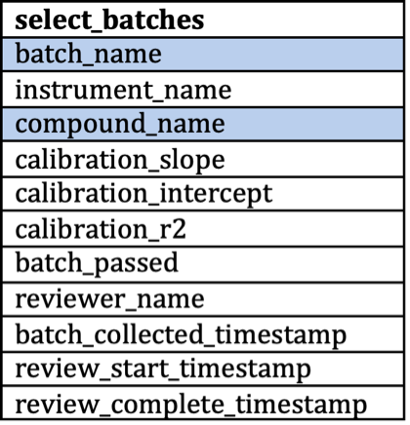
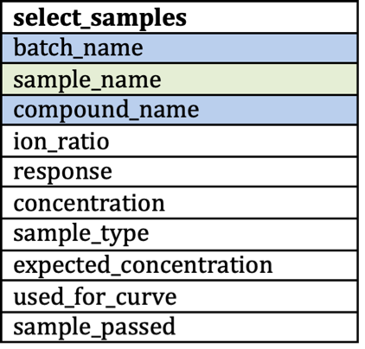
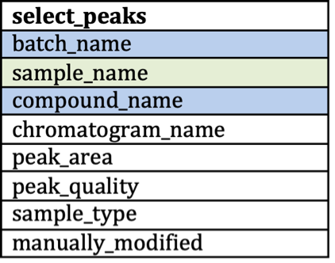
Tables Can Be JOINED with Multiple Keys
batch table
sample table
peak table

Slide 23

THERE ARE MULTIPLE TYPES OF JOINS
Table A
Table B
Table A
Table B
INNER JOIN
LEFT JOIN
Table A
Table B
Table A
Table B
OUTER JOIN
RIGHT JOIN

Slide 24
SQL: JOINING Data from Different Tables
SELECT sample.batch_name, sample.sample_name, sample.compound_name, sample.concentration, batch.instrument_name, batch.reviewer_name, batch.calibration_slope FROM sample INNER JOIN batch ON sample.batch_name = batch.batch_name AND sample.compound_name = batch.compound_name;
columns to output
table to query
table to join with keys to join on

Slide 25
SQL: JOINING Data from Different Tables
batch_name | sample_name | compound_name | concentration | instrument_name | reviewer_name | calibration_slope
b802253 | s253001 | morphine | 0 | doc | Xavier | 0.0077502
b802253 | s253001 | hydromorphone | 0 | doc | Xavier | 0.0076783
b802253 | s253001 | oxymorphone | 0 | doc | Xavier | 0.0079751
b802253 | s253001 | codeine | 0 | doc | Xavier | 0.0081921
b802253 | s253001 | hydrocodone | 0 | doc | Xavier | 0.0065643
b802253 | s253001 | oxycodone | 0 | doc | Xavier | 0.0090238
b802253 | s253002 | morphine | 0 | doc | Xavier | 0.0077502
b802253 | s253002 | hydromorphone | 0 | doc | Xavier | 0.0076783
b802253 | s253002 | oxymorphone | 0 | doc | Xavier | 0.0079751
b802253 | s253002 | codeine | 0 | doc | Xavier | 0.0081921

Slide 26
Relational DBs Allow Efficient Data Storage
peak table
batch table
sample table
Notes:
Why is a database different from a collection of files?
Utility of DB vs. one giant data frame

Slide 27
Mental Model for Relational DBs
Tables store the attributes and records of a data set
Is equivalent to
Data frames store variables describing observations
Approach each analysis problem by asking:
What attributes/variables do I need to answer my question?
How do I know which records/observations to include to answer my question? (What is the inclusion criteria?)

Slide 28
“Tidy Data” Brings Relational DB Concepts to R
Each variable must have its own column.
Each observation must have its own row.
Each value must have its own cell.

Slide 29
Consider a Simple Data Set with 4 Variables
4 variables:
country
year
population
cases

Slide 30
Representation #1
## country year type count ## <chr> <int> <chr> <int> ## 1 Afghanistan 1999 cases 745 ## 2 Afghanistan 1999 population 19987071 ## 3 Afghanistan 2000 cases 2666 ## 4 Afghanistan 2000 population 20595360 ## 5 Brazil 1999 cases 37737 ## 6 Brazil 1999 population 172006362 ## 7 Brazil 2000 cases 80488 ## 8 Brazil 2000 population 174504898 ## 9 China 1999 cases 212258 ## 10 China 1999 population 1272915272 ## 11 China 2000 cases 213766 ## 12 China 2000 population 1280428583

Slide 31
Representation #2
## country year rate ## * <chr> <int> <chr> ## 1 Afghanistan 1999 745/19987071 ## 2 Afghanistan 2000 2666/20595360 ## 3 Brazil 1999 37737/172006362 ## 4 Brazil 2000 80488/174504898 ## 5 China 1999 212258/1272915272 ## 6 China 2000 213766/1280428583

Slide 32
Tidy Representation
## country year cases population ## <chr> <int> <int> <int> ## 1 Afghanistan 1999 745 19987071 ## 2 Afghanistan 2000 2666 20595360 ## 3 Brazil 1999 37737 172006362 ## 4 Brazil 2000 80488 174504898 ## 5 China 1999 212258 1272915272 ## 6 China 2000 213766 1280428583

Slide 33
“Tidy Data” Brings Relational DB Concepts to R
Each variable must have its own column.
Each observation must have its own row.
Each value must have its own cell.

Slide 34
Isn’t this an R Course?
These concepts form the foundation of the tidyverse group of packages
dplyr uses exactly the same SQL concepts, but with R syntax
dbplyr extends the dplyr functions to interact directly with databases
Using relational databases with R can extend your ability to manage large data sets

Slide 35
Lesson Objectives
Understand the structure of the data used for exercises in this course
Define table, attribute, record, and key in the context of relational databases
Write a simple structured query language (SQL) statement to retrieve information from a database
Explain the 3 principles of tidy data

Slide 36
What Else? Learning more about SQL
Relational databases are a common storage format for health care analytics infrastructure
Learning SQL can open up doors to access data
Free online course on SQL: https://www.edx.org/course/databases-5-sql

Slide 37
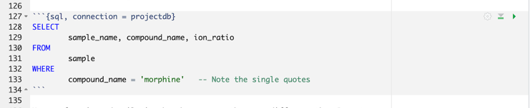
What Else? Running SQL in R Markdown
SQL code can be run within R Markdown/Quarto
Requires connection to database (next lesson)

